Slide 1
Unsolved Mysteries
A detective is on the case

Slide 2
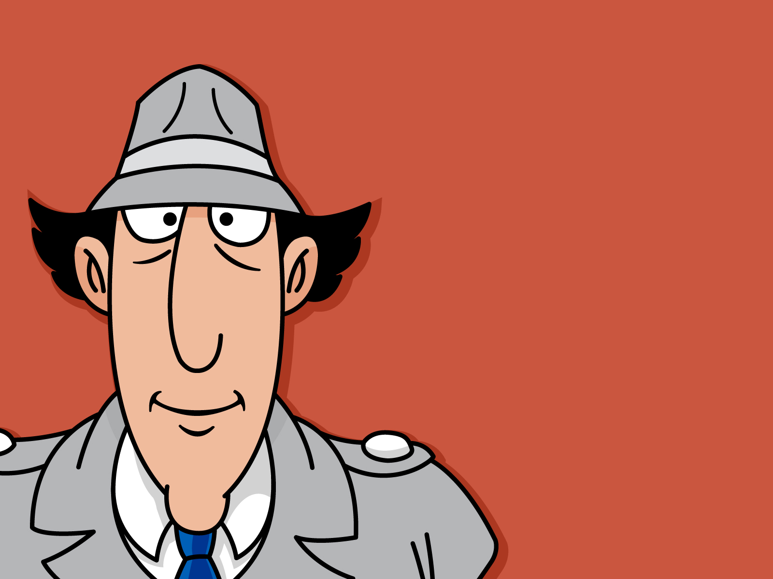

Slide 3


Slide 4

He is solving a puzzle

Slide 5
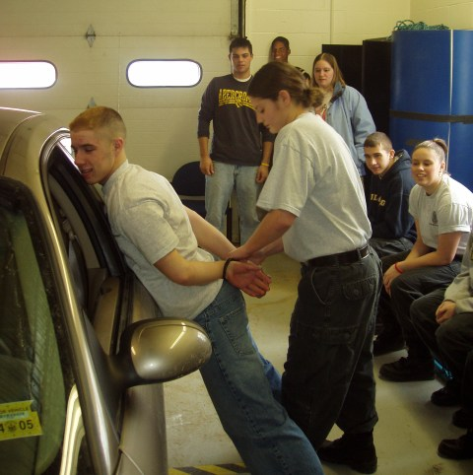
She is catching a criminal

Slide 6
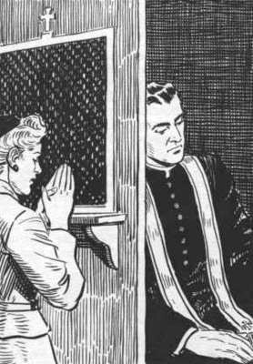
She is making a confession

